Slide 1
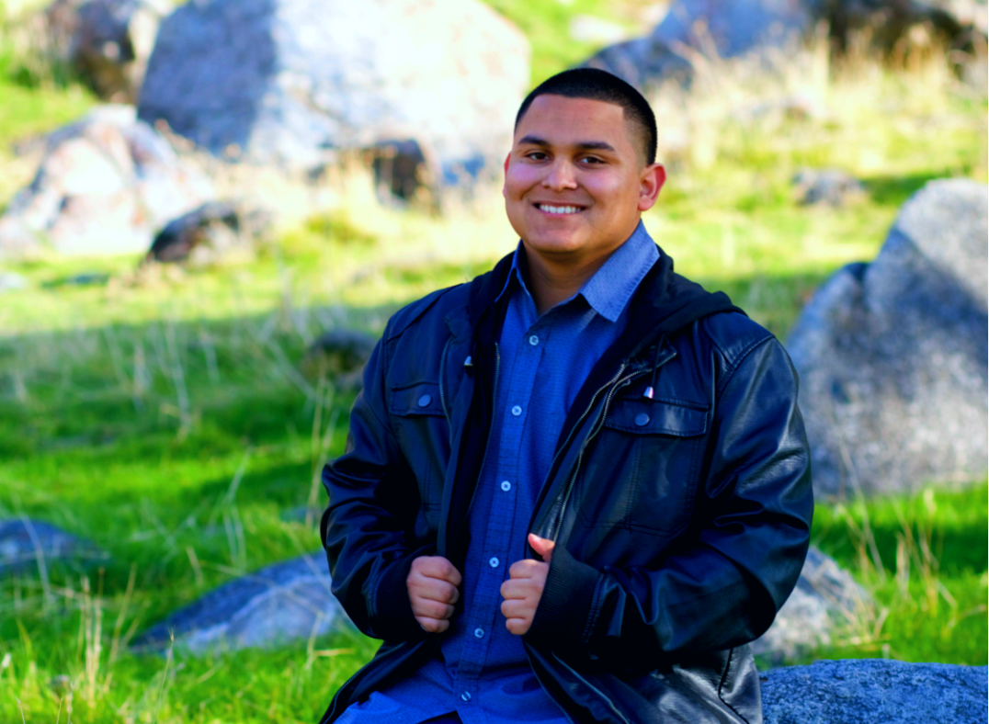
Isaac Hernandez
Lindsay High School
Class of 2017

Slide 2
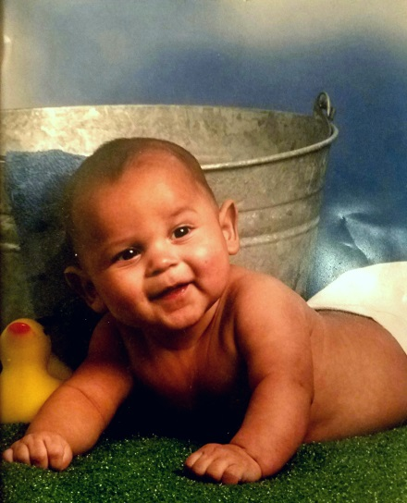
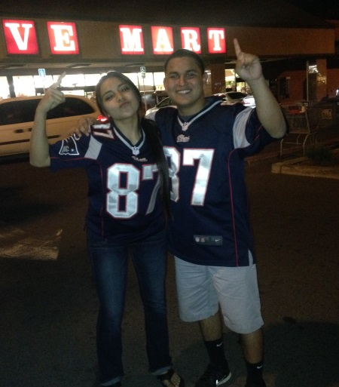
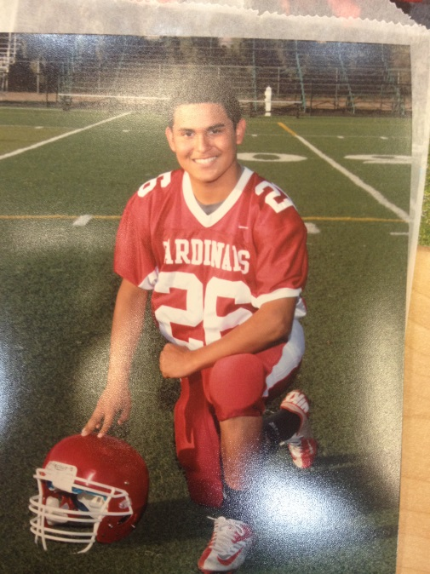
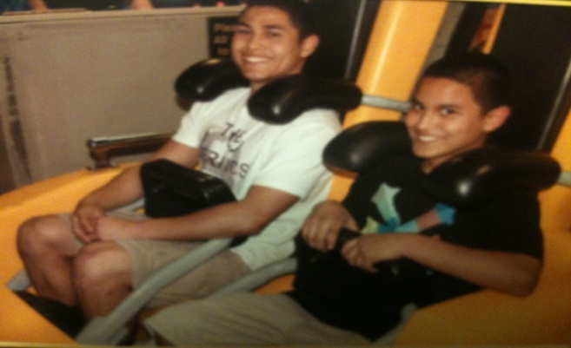
Who am i?
The youngest out of 3
Uncle of 5 (4 Nieces, 1 Nephew)
Golfer
Former Football Player
Born to Richard and
Maryann Hernandez

Slide 3
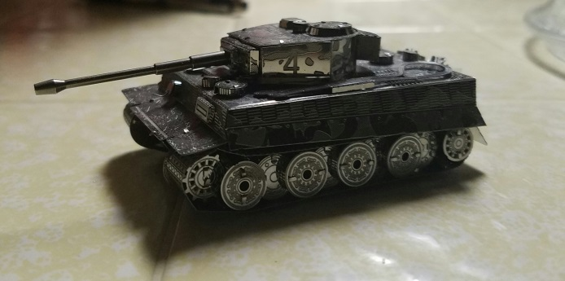
Interests
Reading
Listening to music
Golfing
Building model vehicles
Metal
Wood
Anime
Gaming

Slide 4
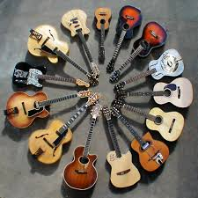
Clubs
Guitar Club (12th)
2016-2017
Wasn’t very interested in clubs throughout high school

Slide 5
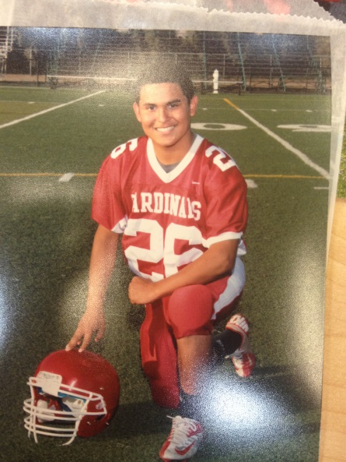
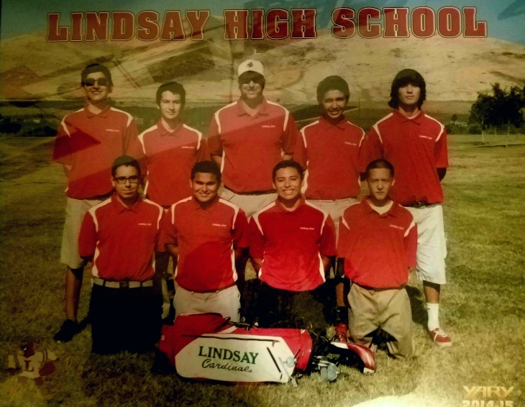
Sports
JV Football (9th)
2013-2014
Varsity Golf (10th-12th)
2014-2017
Varsity Wrestling (12th)
Couldn’t stay with team due to conflicting interests
Team Member for about 2-3 months
Fun experience

Slide 6
Successes and struggles
Successes
Making a lot of friends
Challenging myself and succeeding in classes
Completing required classes early
Struggles
Failing my math class (Pre-Calc)
Attendance
Expectations

Slide 7
Job shadow
Automotive Technician: Jorge Hernandez
Was able to check out the workshop
Talked with some of the other technicians
Introduced to the devices and tools they use regularly
Welcoming experience

Slide 8
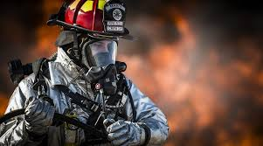
Post-graduation
Attend Porterville College (2-3 years)
General Education
EMT Class
Work to get an AA Degree
Enroll in Fire Academy
Hoping to stay in state and if possible close to home
Visalia
Fresno
ANYWHERE in Northern California

Slide 9
Any questions?

